Slide 1
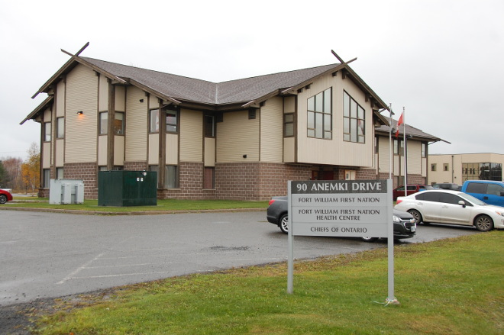
LTC Dilico long term care facility
Land Designation
Information Session
September 21, 2020

Slide 2
Dilico Anishinabek family care long term care (LTC)
objective
On April 17 2018, the Minister of Health and Long Term Care approved phase 1 of the Dilico Anishinabek Family Care Long Term Care (Dilico LTC) proposal for 96 Long Term Care beds on Fort William First Nation. This much needed Long Term Care Facility will require trained and specialized staff both in health care and administrative roles.
Dilico LTC aims to adhere to the principle of increasing Anishinabek staff in the facility. The research completed addresses the labour market issue of the urgent need to ensure community members in the area are identified, trained, and ready to fill the roles created by this large, long-term project.

Slide 3
DILICO ANISHINABEK FAMILY CARE LONG TERM CARE (ltc)
BACKGROUND
Dilico Anishinabek Family Care is a leader in the provision of integrated, holistic, and culturally safe services to urban and First Nation children families and communities. Dilico programs and services are available for Aboriginal and First Nation residents of any age in Dilico’s jurisdiction and for children in the care of Dilico and their caregivers. Dilico is one of the only organizations of its kind in Canada with a mandate to deliver services for the complete life journey of Anishinabek people. The agency is a leader in incorporating traditional values and beliefs and working with Robinson-Superior communities and the affiliated First Nations to make positive change through our knowledge and understanding of the distinctive ways Aboriginal people view health.
As one of the original signatories to the Robinson-Superior Treaty of 1850, Fort William First Nation’s land extends from the north shore of Lake Superior to the height of land separating the Great Lakes watershed from the Arctic watershed. Under provisions of the Robinson-Superior Treaty, the Fort William Reserve was created in 1853. Today, almost 2,200 members live on or off reserve with governance by an elected Chief and Council.

Slide 4
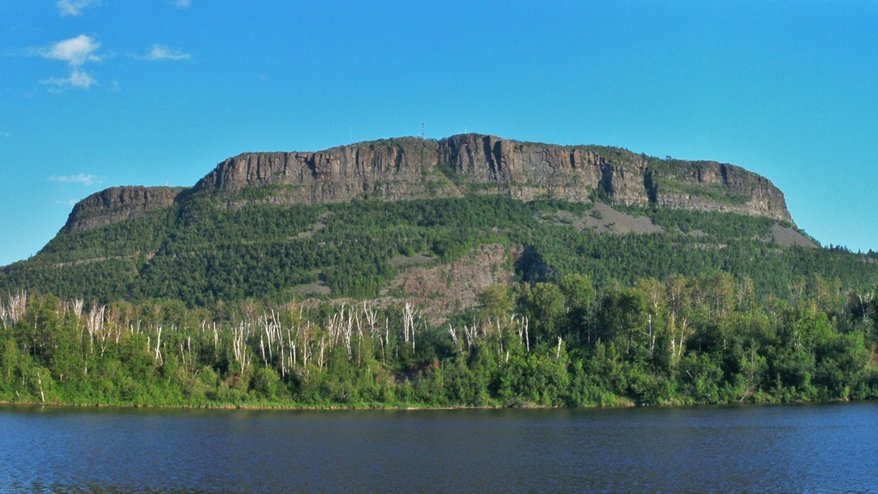
First Nation Communities in Dilico’s jurisdiction are:
Animbigoo Zaagi’igan Anishinaabek
Biinjitiwaabik Zaaging Anishinaabek (Rocky Bay)
Bingwi Neyaashi Anishinaabek (Sandpoint)
Fort William
Ginoogaming
Kiashke Zaaging Anishinaabek (Gull Bay)
Long Lake #58
Michipicoten
Pawgwasheeng (Pays Plat)
Pic Mobert
Biigtigong Nishnaabeg (Pic River)
Red Rock (Lake Helen)
Whitesand

Slide 5
Project

Slide 6
Long Term Care Facility (LTCF)
Purpose, Goal, and Location of the LTCF
The purpose of the LTC facility is to meet the current and growing need for culturally appropriate long term care for Elders
Long Term Care Facilities provide both medical and personal care
The LTC will provide services in a culturally appropriate Indigenous environment
The LTC facility will recognize the value of Indigenous healing practices
The Anemki Site was selected as the preferred location for the facility.

Slide 7
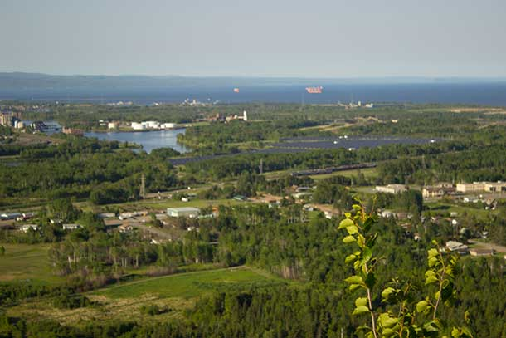
Planning and Design
96 to 128 bed Facility
A part of the planning and due diligence phase of the project, Oshki-Aki Engineering and FORM Architecture were retained to perform the following:
Site Selection Assessment
- Review of transportation, traffic, access, parking, infrastructure, connectivity, landscape, ability to expand, and utility servicing.
- Multiple Sites Assessed within FWFN Community
Design and Layout
- Preliminary building design
- Preliminary Site Layout
- Cost Estimate Evaluation
Community Engagement
- Elders Sessions
- 2 Community Open Houses
- 93 percent of the respondents are in support of the proposed facility being located on Anemki Drive. The remaining 7 percent opted not to respond to the question as they did not have enough information to decide at this point in time.
Land Surveying and Plan
- Land Topographical
- Legal Plan

Slide 8
Exterior 3d rendering
Preliminary Design
SITE PLAN

Slide 9

Questions?

